Slide 1

Basic HTML
Pemrograman Berbasis Web 1
D3 Rekayasa Perangkat Lunak Aplikasi
Telkom University
2022

Slide 2

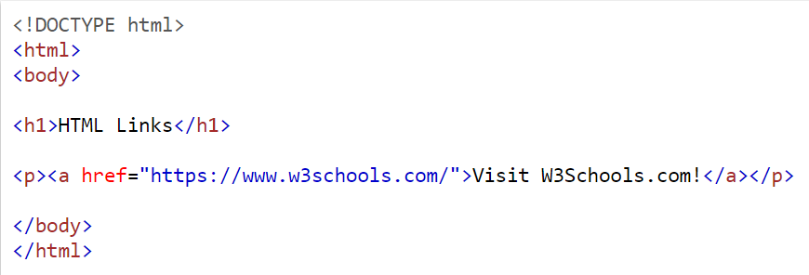
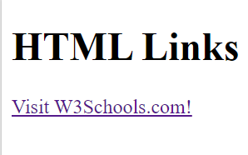
HTML Links - Hyperlinks
The HTML <a> tag defines a hyperlink. It has the following syntax:
Example:

Slide 3
HTML Links - The target Attribute
By default, the linked page will be displayed in the current browser window. To change this, you must specify another target for the link.
The target attribute specifies where to open the linked document.
The target attribute can have one of the following values:
_self - Default. Opens the document in the same window/tab as it was clicked
_blank - Opens the document in a new window or tab
_parent - Opens the document in the parent frame
_top - Opens the document in the full body of the window
Example:
Use target="_blank" to open the linked document in a new browser window or tab:

Slide 4
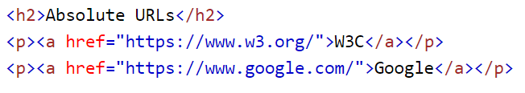
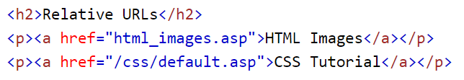
Absolute URLs vs. Relative URLs
Absolute URLs : a full web address in the href attribute
Relative URLs: a link to a page within the same website without the "https://www" part

Slide 5
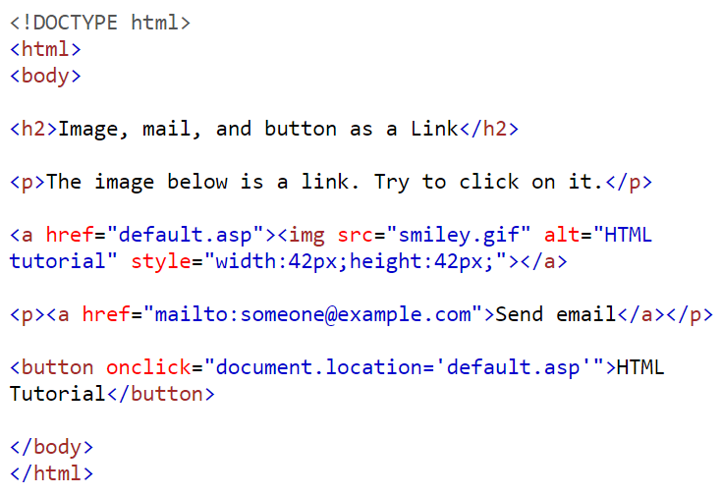
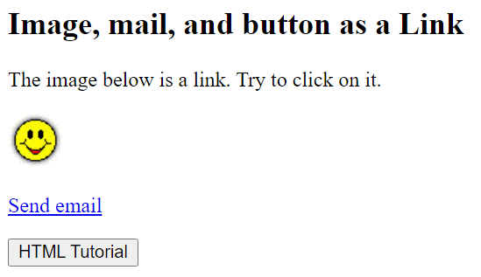
Other HTML Links: image, email, button

Slide 6
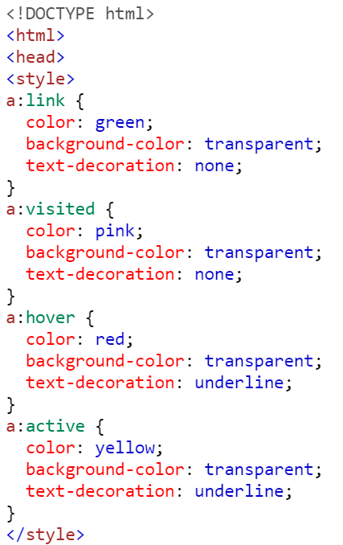
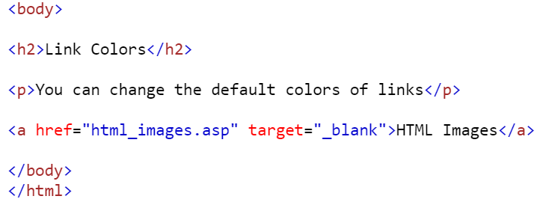
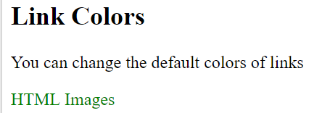
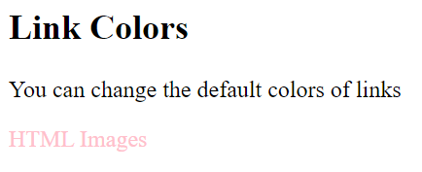
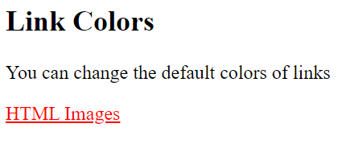
HTML Links - Different Colors
Example
an unvisited link will be green with no underline.
a visited link will be pink with no underline.
An active link will be yellow and underlined.
In addition, when mousing over a link (a:hover) it will become red and underlined:
Code continue
The yellow color will appear when the link is clicked

Slide 7
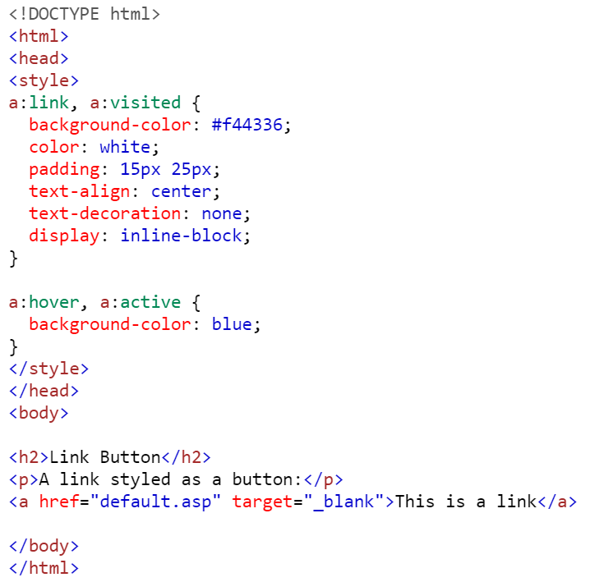
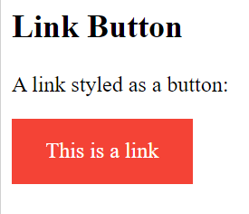
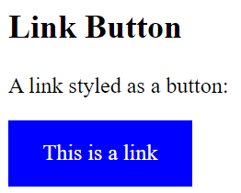

Slide 8
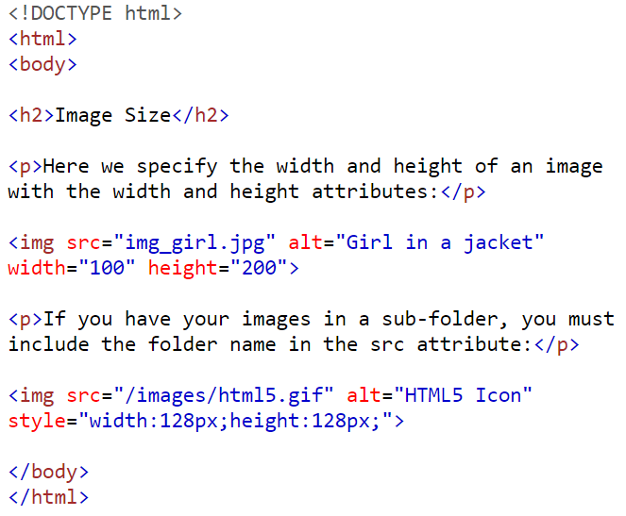
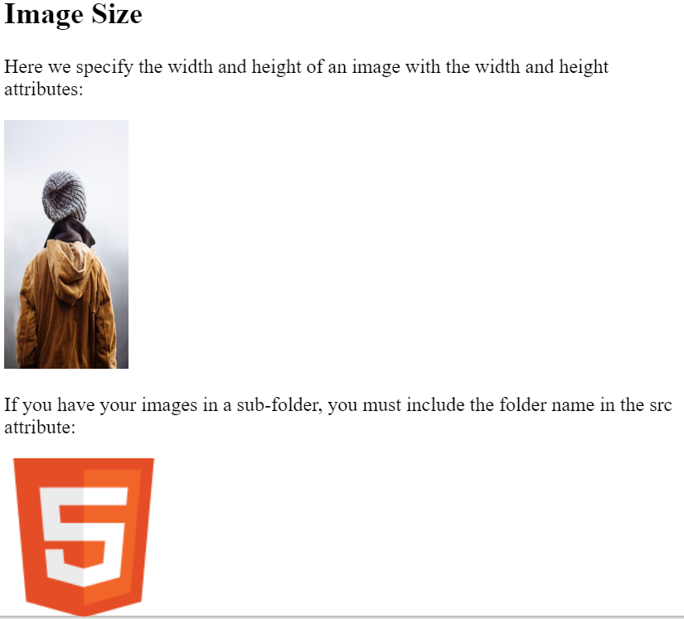
HTML Images – Size and Folder

Slide 9
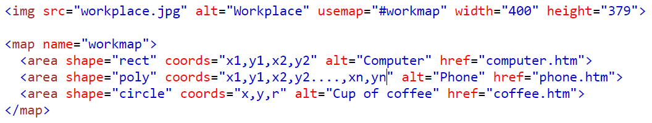
Image Maps
The HTML <map> tag defines an image map. An image map is an image with clickable areas. The areas are defined with one or more <area> tags.
You must define the shape of the clickable area, and you can choose one of these values:
rect - defines a rectangular region
circle - defines a circular region
poly - defines a polygonal region
default - defines the entire region
You can use Image Editor (Photoshop or GIMP) to obtain coordinates

Slide 10
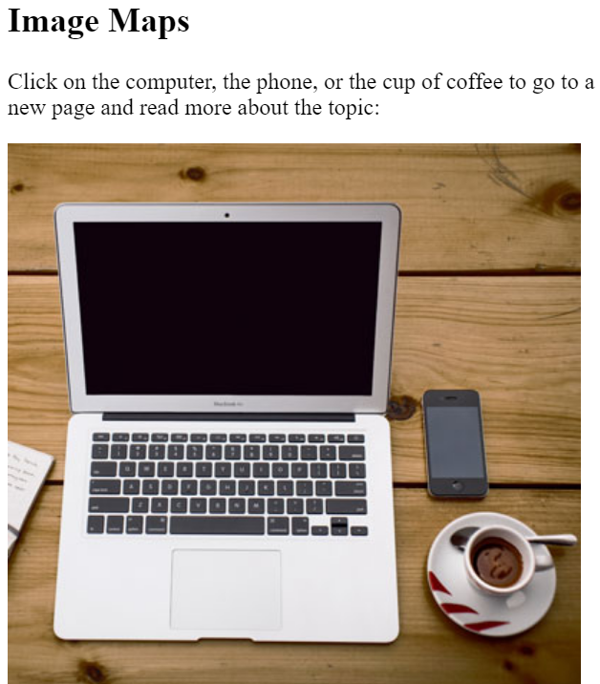
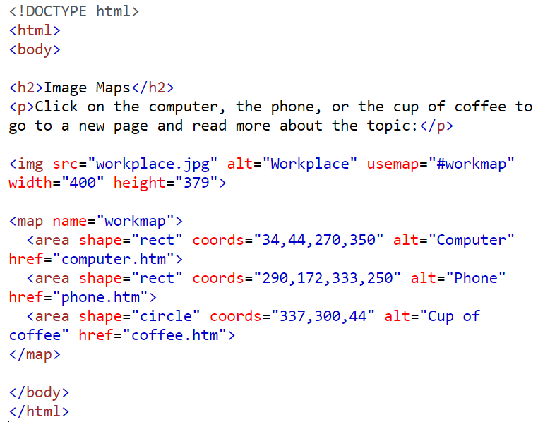
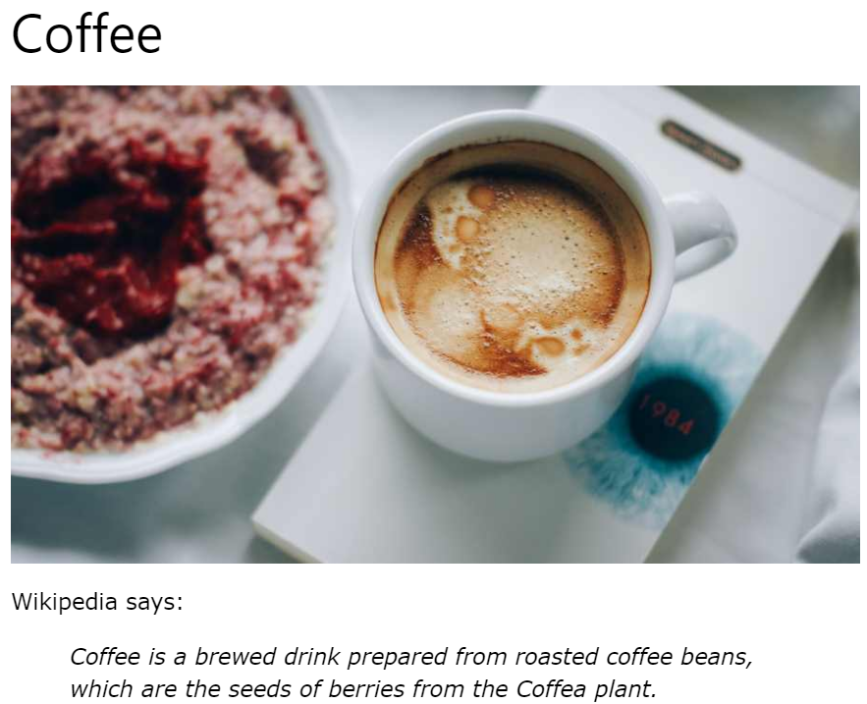
Image Maps Example
When an image of the glass of coffee clicked, coffee.htm will be displayed

Slide 11
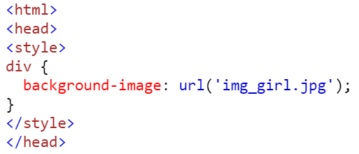
HTML Background Images
To add a background image on an HTML element, use the HTML style attribute and the CSS background-image property:
Add a background image on a HTML element:
You can also specify the background image in the <style> element, in the <head> section:

Slide 12
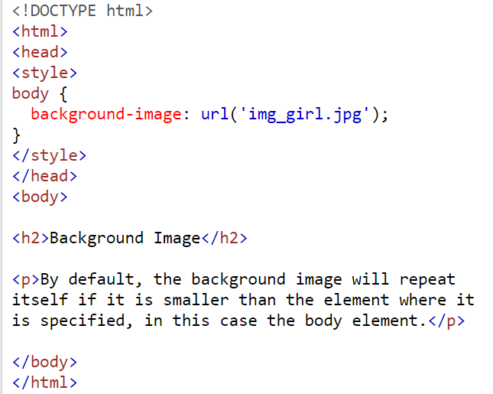
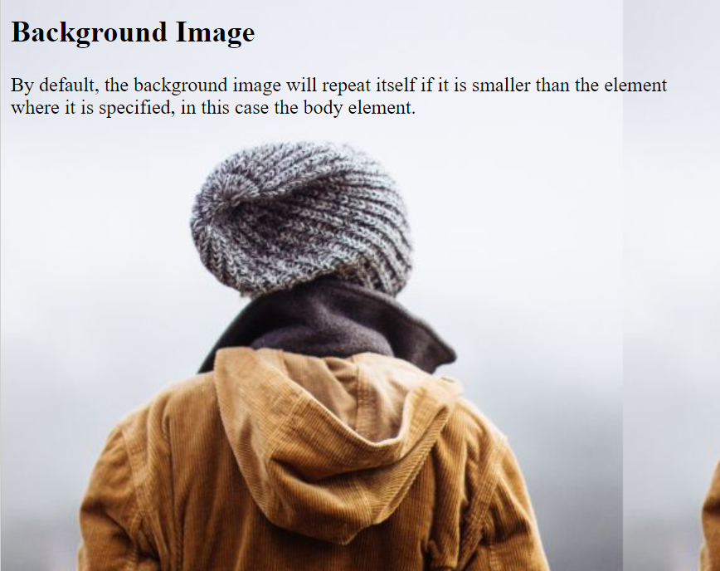
Background Image

Slide 13
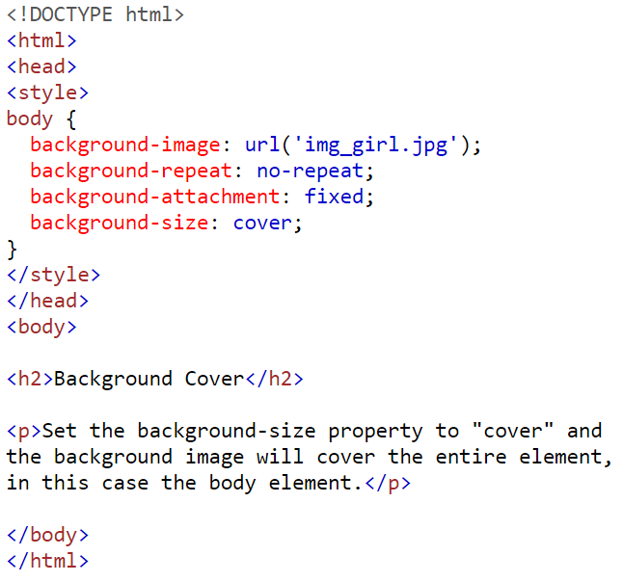
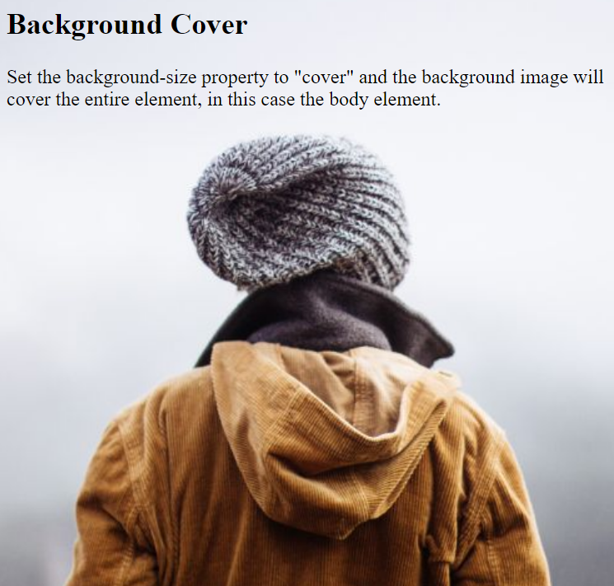
Background Cover

Slide 14
HTML Table
The <table> tag defines an HTML table.
Each table row is defined with a <tr> tag.
Each table header is defined with a <th> tag.
Each table data/cell is defined with a <td> tag.
By default, the text in <th> elements are bold and centered.
By default, the text in <td> elements are regular and left-aligned.

Slide 15
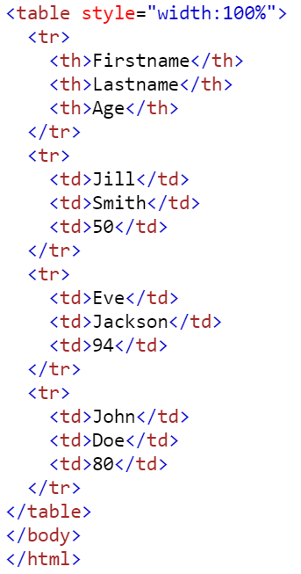
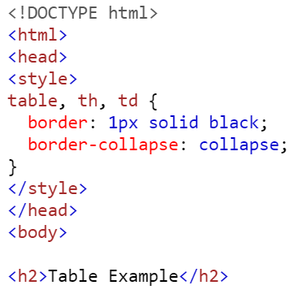
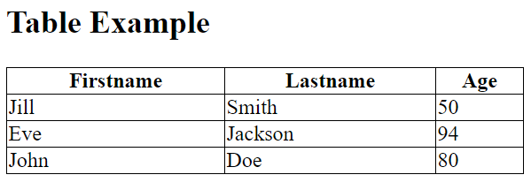
Example
Continue

Slide 16
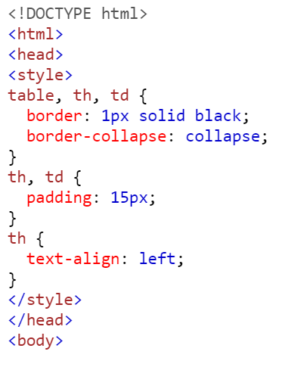
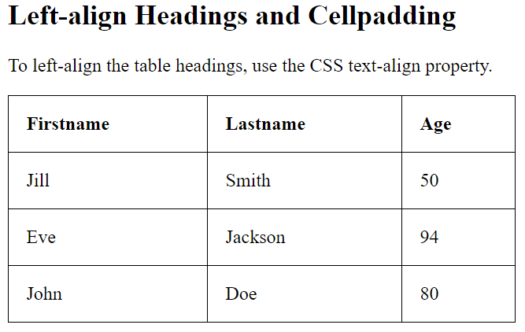
Add Cellpadding and Text Align
padding
The code continues the same as in the previous slide

Slide 17
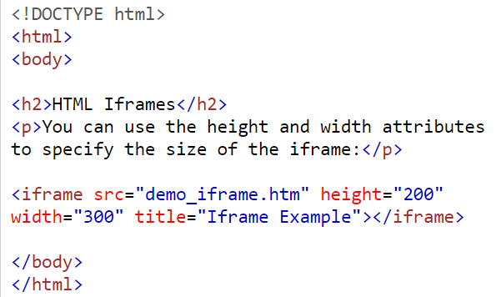
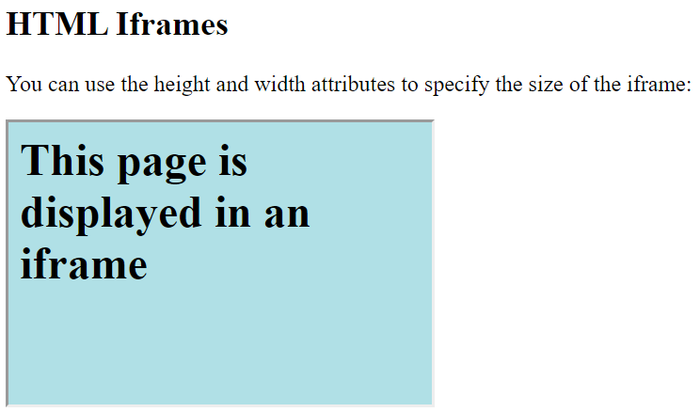
HTML Iframes
An HTML iframe is used to display a web page within a web page.
The HTML <iframe> tag specifies an inline frame. iFrame syntax:
Use the height and width attributes to specify the size of the iframe.

Slide 18
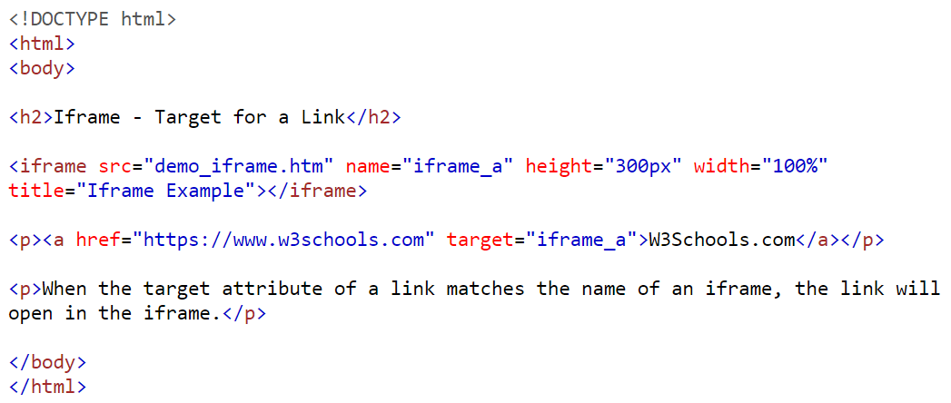
Iframe - Target for a Link
An iframe can be used as the target frame for a link.
The target attribute of the link must refer to the name attribute of the iframe:
See the result in the next page

Slide 19
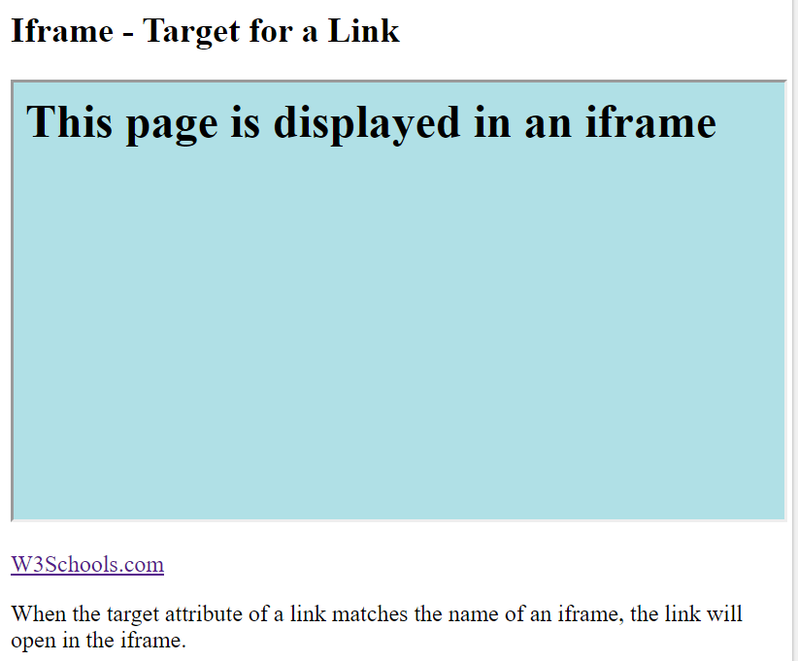
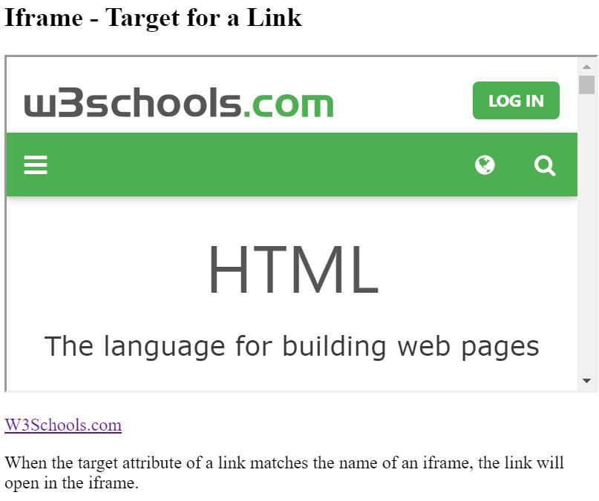
Click the link: w3schools web page will appear on iFrame

Slide 20
HTML JavaScript
JavaScript makes HTML pages more dynamic and interactive.
The HTML <script> tag is used to define a client-side script (JavaScript).
The <script> element either contains script statements, or it points to an external script file through the src attribute.
Common uses for JavaScript are image manipulation, form validation, and dynamic changes of content.
To select an HTML element, JavaScript most often uses the document.getElementById() method.

Slide 21
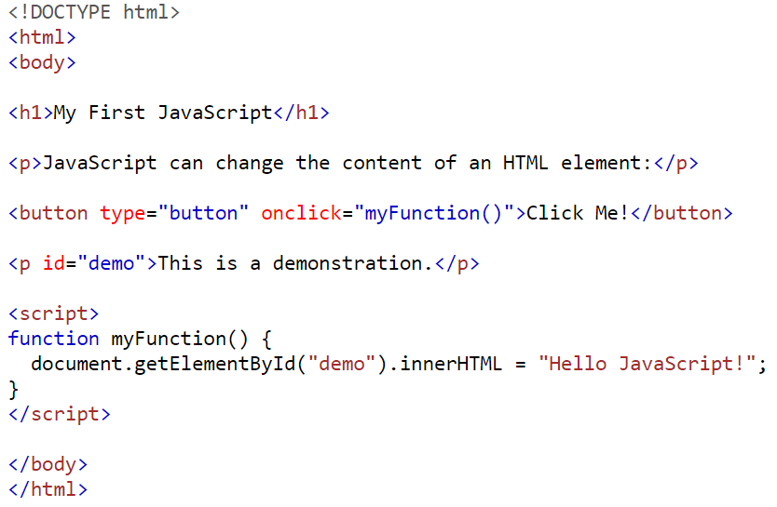
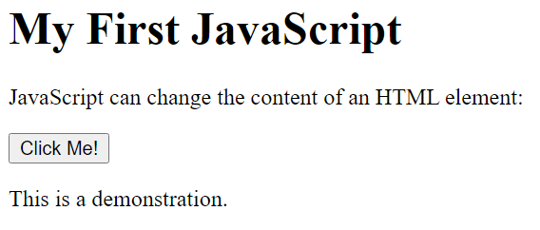
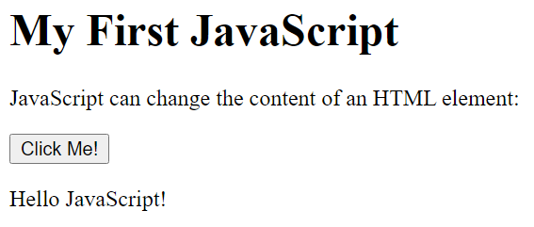
First Javascript Example – Click Me!

Slide 22
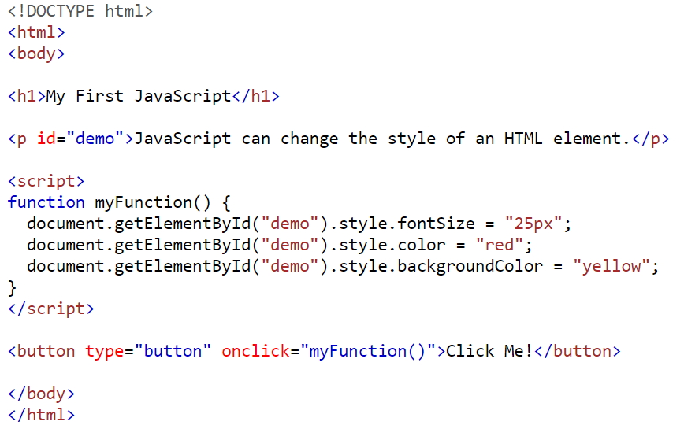
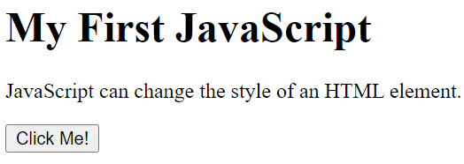
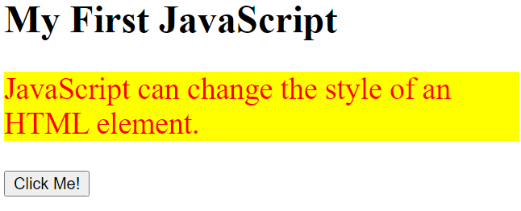
Change my style!

Slide 23
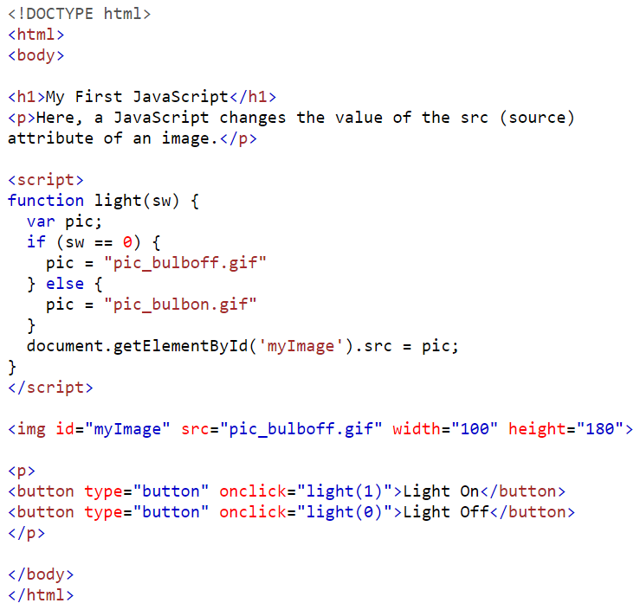
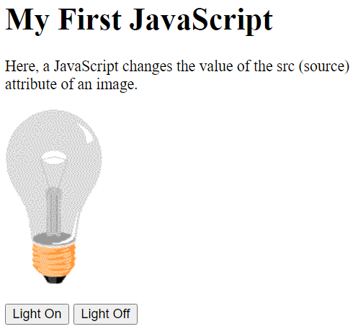
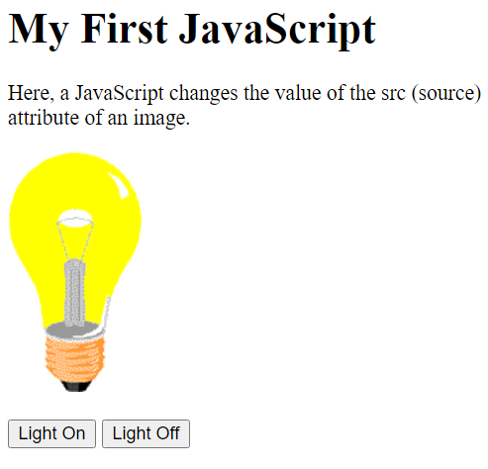
Light on - off

Slide 24
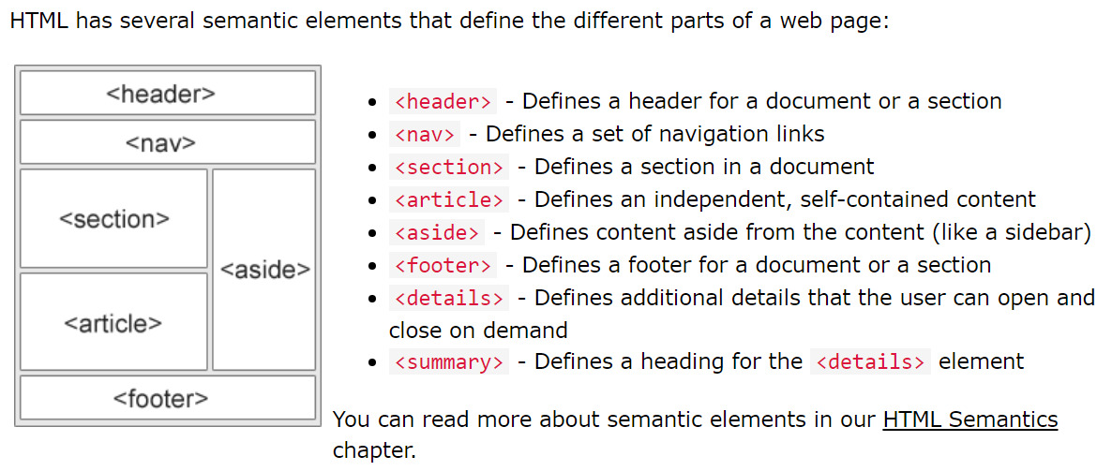
HTML Layout Elements

Slide 25
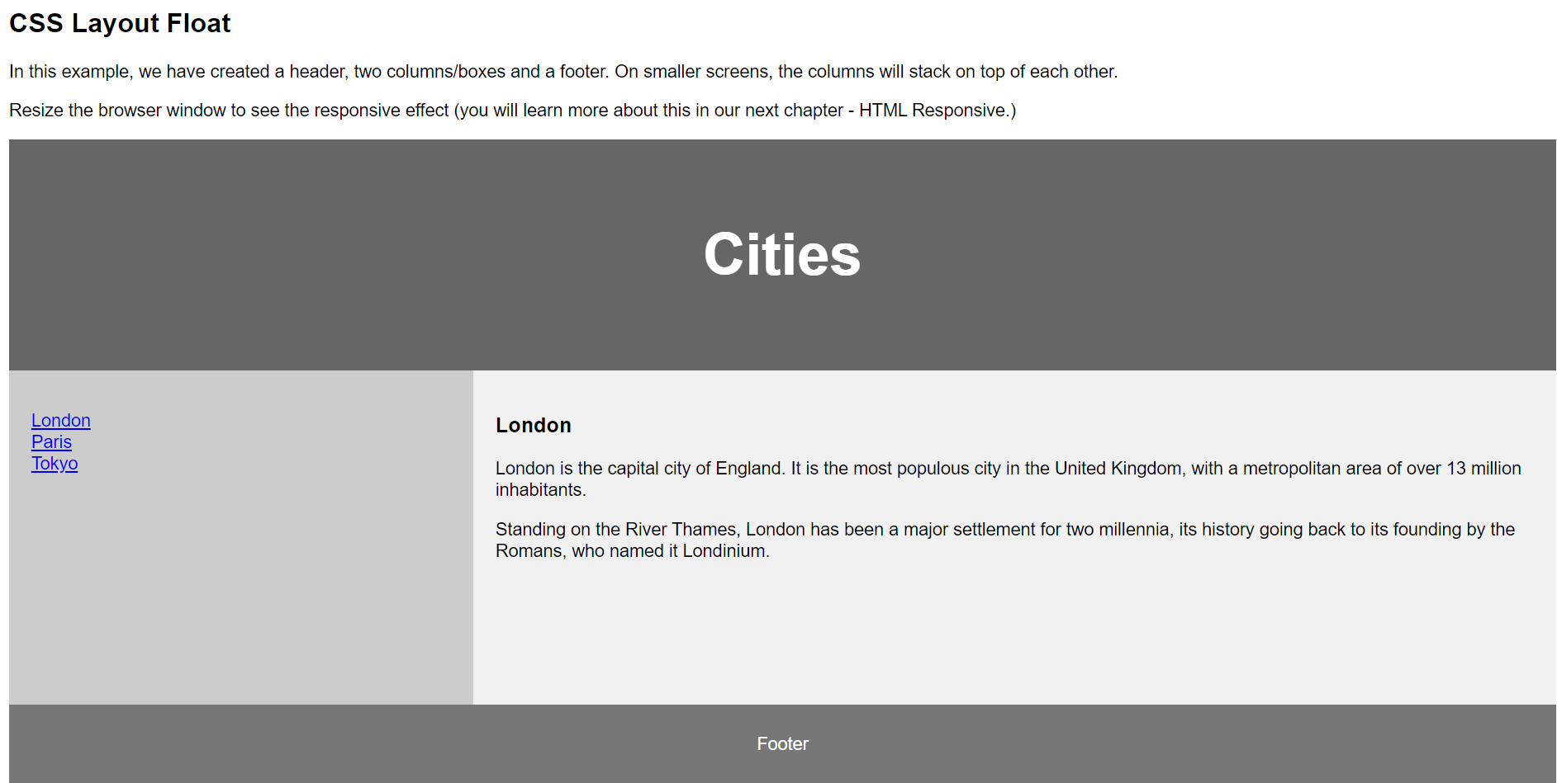
HTML Layout Example

Slide 26
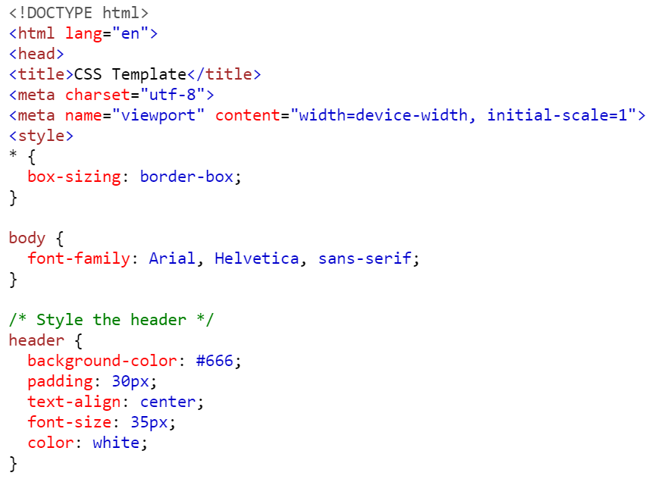
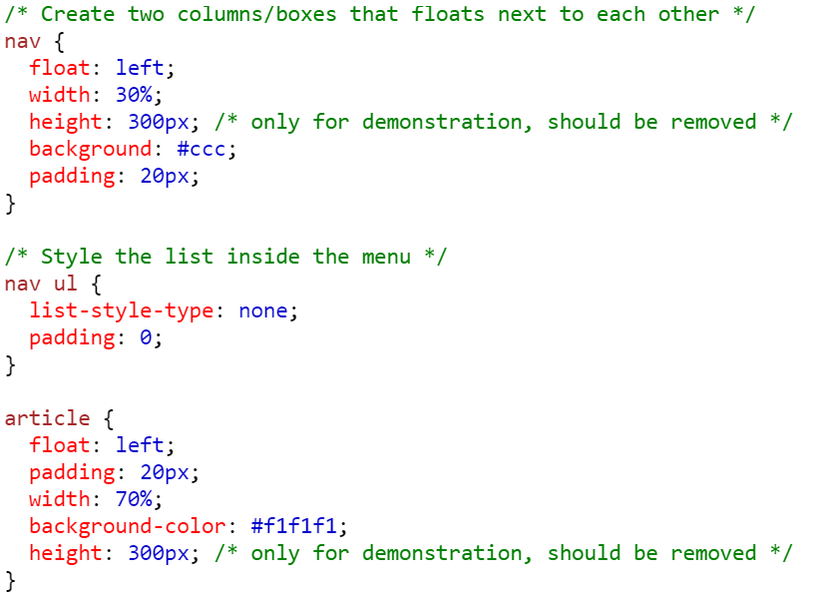
HTML Layout Example – The Code (1)
Part 1
Part 2

Slide 27
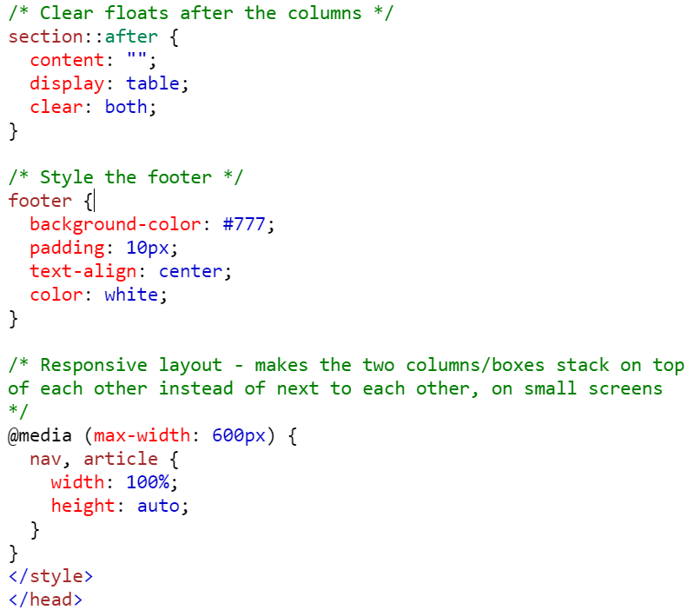
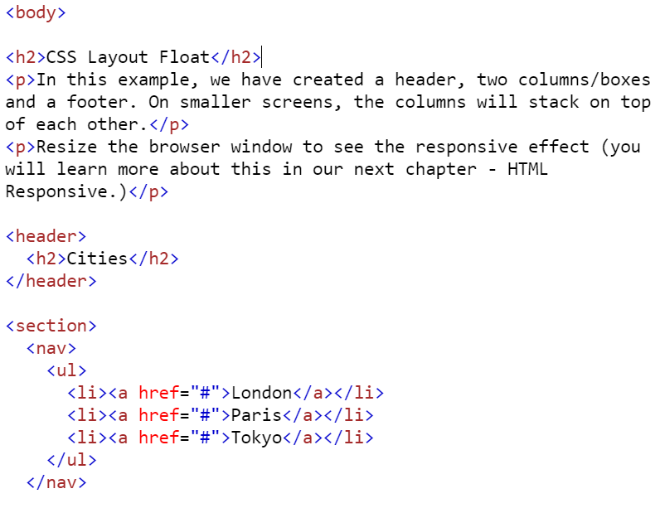
HTML Layout Example – The Code (2)
Part 3
Part 4

Slide 28

HTML Layout Example – The Code (3)
Part 5

Slide 29
Second Lab Assignment
Buat halaman web sederhana menceritakan tentang kota asal kalian.
Konten bebas seperti: tempat terkenal, makanan khas, Bahasa, tempat wisata, dll
Ketentuan Rubrik Penilaian:
Menggunakan Link huruf dan image dan button (15%)
Menggunakan Image Maps (15%)
Menggunakan iFrame (10%)
Menggunakan Table (10%)
Menggunakan JavaScript (20%)
Menggunakan Layout (30%)
Dikumpulkan sesuai jadwal pada akhir praktikum. Link pengumpulan akan diumumkan selanjutnya.

Slide 30
Reference
https://www.w3schools.com/html/default.asp

